Slide 1
Building Strong
Team-Based Leadership

Slide 2
Delaware's state-level Social, Emotional and Behavioral Wellbeing (SEBW) Plan aids districts and charter schools in responding to and supporting the social, emotional and behavioral needs of students. This plan is supported by Delaware Department of Education (DDOE) and developed with input and support from partners, including the following:
Delaware's SEBW Plan was developed with the understanding that each district and charter school is in a different place in its implementation of Multi-Tiered Systems of Support (MTSS), other initiatives and available resources. The plan is funded in part by federal ESSER II funds.

Slide 3
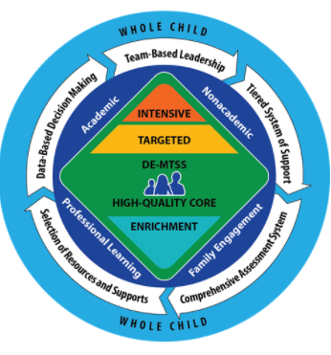
DE-MTSS Framework
“DE-MTSS is a framework designed to meet the needs of the whole child through an integrated, multilevel prevention system that optimizes team-based leadership and data-driven decision making to meet the academic and nonacademic (e.g., behavioral, social and emotional) needs of all students.”
DDOE. (2021). Delaware’s MTSS Framework

Slide 4
Strategies for Effective Teaming
Clear mission and purpose
Agreements and norms
Specified meeting roles
Structured agenda
Annual timetable for agenda items
Mcintosh & Goodman, 2016 and DE-MTSS Modules

Slide 5
Intended Audience + Module Goals
Ideal viewing audience: educational teams or committees
Teams may be State-, district- and/or school-level
Examples include:
Integrated academic and nonacademic MTSS teams
Academic-focused team or subcommittee
SEBW-focused teams
Grade-level teams
Increase individual and team-based knowledge on successful teaming foundations including process, structures, norms, and systems
Action plan around teaming foundations and apply to your own teams to improve functionality and outcomes

Slide 6
Teams become more efficient and effective at solving problems with:
Meeting foundations (e.g. team vision, purpose/norms, authority, roles, agenda)
Data (timely, accurate, accessible)
Data informed decision making routines (e.g., defining problems with precision, building goals, monitoring implementation)
Teaming slides have been adapted from Rob Horner, available at Team Initiated Problem Solving (TIPS) Training

Slide 7
Keys to Successful Teaming & Meeting Foundations
Predictability
Positivity & Safety
Consistency
Accountability
TIPS

Slide 8
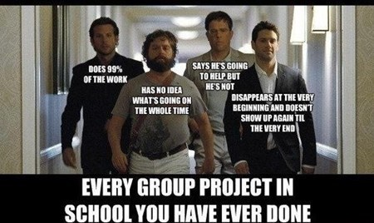
Ever Been a Part of This Team?
Mid Atlantic PBIS

Slide 9
Habits of Inefficient and Ineffective Teams....
Meet without establishing their purpose, process and roles
Meet without data or use data to describe rather than solve a problem
Define problems with limited precision (e.g., the kids are rude in the cafeteria) and adopt solutions that are a poor match with the problem (e.g., a packaged social skills program)
Reactive
Habits of Efficient and Effective Teams….
Have a clear purpose, authority, efficient process, and defined roles
Transform data into clearly defined problems and solutions
Improve the likelihood their solutions are implemented
Improve the likelihood of improvement in student outcomes (both academic and non-academic)
Proactive
Adapted from Todd et al. (2019)

Slide 10
Team Time
Refer to activity #1 on your Building Strong Team-Based Leadership Module: Team Time Companion Guide
Reflect individually on personal teaming experiences briefly
As a team, discuss experiences you have mutually had dealing with effective vs. ineffective teaming habits
Together, identify 2-4 commonalities in both effective and ineffective teaming experiences and make note of them in your companion guide.
1

Slide 11
Why is teaming so important?
Helps distribute the workload among members so that leadership is shared
Ensures that the work can be sustainable, wherein if a member of the team leaves, the processes and structures in place can continue and do not leave with that person
Provides the infrastructure for systemwide evaluation and continuous improvement
AIR. Center on MTSS

Slide 12
Team Representation
Reflective of the population the team represents
Representative of key stakeholders
Can speak to desired team outcomes
Ability to make important decisions
Gives voice to students, families, community, BIPOC, LGBTQ+, disability community, behavioral and mental health needs, and other typically underrepresented groups
How are we organized to do WITH and not do TO?
- Kim Yanek

Slide 13
Team Membership
Recruit Community Members
Recruit Students and Family Members
Include diverse perspectives & practices into implementation
Is team representative of the culture & diversity of the community? And the needs?

Slide 14
Team Time
Refer to activity #2 on your Teaming Module Companion Guide
List the name and position of each individual on your team
Review thought prompts on team representation to determine how your team membership could be expanded or adjusted
2

Slide 15
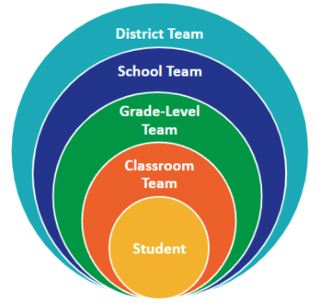
MTSS Teams
“There is no ideal team makeup or number of teams that will work perfectly in each school, but knowing the makeup and functions of each team can assist selecting which teams to add or combine.”
Mcintosh & Goodman, 2016 and DE-MTSS Modules

Slide 16
Working Smarter - Team/Committee Map
District Level Team/Committee | Purpose and Goals Supported | Measurable Outcome(s)- Data-Based | Target Group | Staff Involved | How often? | Strategic Plan
Goal: Identify the need for a new team or expansion/modification of existing team to fulfill goals of district or school strategic plan

Slide 17
Team Time
Refer to activity #3 on your Teaming Module Companion Guide
Download the hyperlinked Working Smarter Team/Committee Mapping Worksheet
Follow outlined steps on the worksheet to map teaming structures, identify the need for a new team or expansion/modification of existing team to fulfill goals of district or school’s Strategic Plan
3

Slide 18
Communication Planning
Communication with internal and external stakeholder groups
Cross team representation
Consistently used communication tools
Central communication system
MOUs with external agencies
Alignment and/or integration of efforts/initiatives/funding/policies

Slide 19
Communication Plan Template
Mission and Purpose of Communication Plan What is the clear purpose and mission of the communication plan?
Practice-Policy Communication Cycles Who is responsible for ensuring feedback and information gathered through communications are used to inform, reduce barriers, and celebrate successes?
Information or Messages What needs to be communicated? How does the information change over time as the organization goes deeper into practice? | Audience (Diverse Stakeholders) Who needs to be communicated with? | Methods Are a variety of modes used: conference key notes, presentations, meetings, Webpages, Webcasts, etc.? | Frequency How often? Is there a schedule? | Responsibility Who is responsible? What is the role of leadership? | Indicator of Success What data is used and how often to determine effectiveness of communication?
Yanek, K. (2021, August 11). Project DelAWARE & Interconnected Systems Framework (ISF)

Slide 20
Team Time
Refer to activity #4 on your Teaming Module Companion Guide
Follow prompts on the hyperlinked Communication Plan Template to create a cohesive plan
4

Slide 21
Why are Meeting Foundations important?
Biggest meeting challenge = off-topic conversations.
Martin, 2020
The five main meeting problems are:
lack of participant preparation (28%)
no follow-up on tasks (25%)
poor communication (20%)
time allocated is not observed (17%)
no minutes (13%)
Turmel, 2022
The top reason people selected as the best way to get them excited about attending a meeting is for it to be well-planned (64%)
Martin, 2020
Team Initiated Problem Solving (TIPS) Training

Slide 22
Critical Elements of Meeting Foundations
Team Purpose, Functions, Authority
Team Meeting Process (e.g., Agreements/Expectations)
Team Meeting Roles and Responsibilities
Team Organization
Flow of Team Meeting
TIPS II

Slide 23
Team Purpose, Functions, Authority
Purpose: Clear and functional! Why are we here? What is our shared mission?
Function: What do we need to accomplish during our time together? What do we have to accomplish and what do we want to accomplish? What are our goals? What is expected of us?
Authority: Which stakeholders do we need to collaborate with, respond to, and communicate with?

Slide 24
Purpose, Functions, Authority: SEB Committee Example
Purpose
Establish, monitor and improve a positive social culture for the school
Function
Select and teach school wide social, emotional and behavioral expectations
Establish a system to acknowledge positive behavior
Establish a system to respond constructively to behaviors of concern
Collect data, monitor to inform Tier 1 SEB systems & practices
Authority
Active administrator participation
Monthly report to MTSS leadership and faculty
Implement approved practices and systems

Slide 25
Team Time
Refer to activity #5 in your companion guide
Discuss and identify the purpose, function, and authority of your team
5

Slide 26
Team Meeting Process
(e.g. Agreements/Expectations)
Team meeting processes ensure that teams have efficient and predictable meetings
Establishing shared core values
e.g. Respect, Honesty, Communication
Shared values become expectations/community agreements/norms
Guide behavior, cultivate trust & safety, sustain emotionally intelligent practices
Living and useful
3-5 positively stated expectations

Slide 27
Defining Expectations with Behaviors/Norms
How can a team’s shared values and expectations be operationally defined?
e.g. What does Respect look like in a team meeting?
What do expectations look and sound like in action?
Procedural examples vs Behavioral examples
Make expectations visible
Create Structures for Accountability
The Art of Coaching Teams by Elena Aguilar

Slide 28
We are...
Engaged | Take breaks and use other self care strategies (biological, mental, emotional) Invite and welcome the contributions of every member and listen to each other Keep cameras on and unmute to share Use group chat feature to share questions, resources, ask about concerns, and make jokes
Reflective | Share questions to process as a team Focus on problem solving around areas of concern Consider multiple perspectives and stay flexible Use agenda and notes to revisit conversations and tasks Use and make decisions based on data (outcomes and perceptions)
Supportive | Share successes, challenges, ideas, useful resources Share your own needs (when helpful) and respect others’ needs Listen with openness and understanding and assume best intentions
Collaborative | We are not here to be right, we are here to get it right Express concerns using “I” statements and stay solution-focused Listen to understand and be open to possibilities Keep what’s best for students and families at the center
Delaware Positive Behavior Support Project

Slide 29
Expectations/ Values | Behaviors/Skills/Norms
We are Responsible | Make yourself comfortable (wellness) Take care of your needs (biology, mental, emotional) (wellness) Consider, I am not here to be right, I am here to Get It Right (practice empathy)
We are Respectful | Listen to understand Use “Oops” and “Ouch” Assume best intentions Practice perspective-taking
We are Safe | Ask for clarity to understand and contribute Create a safe space that invites open dialogue and vulnerability – Consider the 3 Gates of Speech: Is what you want to say Kind? True for you? Necessary?
(practice empathy)
Yanek, K. (2021, August 11). Project DelAWARE & Interconnected Systems Framework (ISF)
Notes:
29

Slide 30
Team Time
First, use the instructions found on the Core Values worksheet linked in the companion guide under activity #6. This will determine everyone’s individual top 3 core values.
Which core values does the team want to become shared values? Agree upon 3-5 values that will become the team’s expectations.
Then, operationally define the expectations by deciding what they each look and sound like.
Utilize the behavior matrix template linked under activity #6 to create the team’s matrix.
6

Slide 31
Team Meeting Roles and Responsibilities
Facilitator
Ensure the group moves smoothly through tasks!
Note Taker
Write down the work of the group!
Data Analyst
Creates data summaries for the team
Time Keeper
Keep up with time!
Active Team Members
Stay engaged
Authority
Power to make decisions
Assign a back up for each role!

Slide 32
Before the Meeting …
Facilitator | Room reserved/Zoom link created and shared “New” items solicited for agenda (from stakeholders and team members) Agenda produced in question format Lead team through discussion of effects of in-process solutions on “old” problems
Time Keeper | Secure time keeping device/establishing reminder system☺
Note Taker | SMART Board reserved & room set up to project agenda, minutes, data or prep is done to screen share virtually Electronic system for notetaking established and shared
Data Analyst | Data reviewed before the meeting; Suggest possible new issues

Slide 33
During the Meeting …
Facilitator | Start/end meeting on time Review times for each agenda item with team Identify next meeting time, date and roles Manage flow of meeting by adhering to agenda Ensure active participation of all team members
Time Keeper | Keep track of time spent on each agenda item. Give signal if the time for an agenda item has passed. Let the team know the time is up and ask if they would like to add more time to the agenda for this item
Note Taker | Ask for clarification of tasks and complete meeting minutes
Data Analyst | Leads discussion & answers questions about Data Analyst’s Report & provides additional data requested

Slide 34
After the Meeting …
Facilitator | Ensure meeting minutes, goals, data & decisions are shared with stakeholders
Time Keeper
Note Taker | Meeting minutes and problem solving action plan completed Copy of meeting minutes and action plan kept within shared & accessible location and distributed to each member within 24 hours
Data Analyst | Ensures data is accurately reported out and kept updated

Slide 35
Team Time
Refer to activity #7 in your Teaming Module Companion Guide
Review team meeting core roles and identify individual team members who will serve in these roles
Be thoughtful about individual strengths, interests, and capacity
Don’t forget to identify a back-up for each role!
Remember that these roles are fluid - they are not set in stone forever and should be revisited and reexamined
7

Slide 36
Team Organization
(write it down!)
Member Names/Attendance/Roles
Team Shared Expectations
Agenda Items (and allotted time)
Progress Updates
Action Planning
Organizational/Housekeeping Task List
Plans for Next Meeting
Prompts for Evaluation & Self-Reflection

Slide 37
Team Time
Refer to activity #8 in your companion guide
Review the Team Meeting Agenda Template
Adapt to fit your team’s needs and commit to using this structure regularly
8

Slide 38
Flow of Team Meeting
Call meeting to order
Review the agenda for today
Update progress on previously discussed items
Discuss new items
Discuss organizational/housekeeping items
Wrap up meeting
Adapted from Team Initiated Problem Solving (TIPS) Training Materials www.pbis.org

Slide 39
Fidelity Checks & Self-Assessment
Collective reflection
Individual and collective team functioning
Increase in self-awareness
Impact on behavior change
Individual and mutual accountability and buy-in
Improvement in successes and outcomes
The Art of Coaching Teams

Slide 40
Tiered Fidelity Inventory
Purpose: “to provide a valid, reliable, and efficient measure of the extent to which school personnel are applying the core features of school-wide positive behavioral interventions and supports (SWPBIS).”
Nationally used team-based self-assessment
Schools may take the TFI as:
An initial tool to determine how to action plan for SWPBIS
A guide for implementation of Tier I, Tier II, and/or Tier III
An index of sustained SWPBIS implementation
Results are a springboard for action planning
Recommendation: 3 times/year
SWPBIS Tiered Fidelity Inventory version 2.1

Slide 41
Feature | Possible Data Sources | Scoring Criteria
1.1 Tier 1 team includes a Tier 1 systems coordinator, a school administrator, a family member, and individuals able to provide (a) applied behavioral expertise, (b) coaching expertise, (c) knowledge of student academic and behavior patterns, (d) knowledge about the operations of the school across grade levels and programs, and for high schools, (e) student representation. | • School organizational chart • Tier 1 team meeting minutes | 0 = Tier 1 team does not exist or does not include coordinator, school administrator, or individuals with applied behavioral expertise 1 = Tier 1 team exists, but does not include all identified roles or attendance of these members is below 80% 2 = Tier 1 team exists with coordinator, administrator, and all identified roles represented, AND attendance of all roles is at or above 80%
2.1 Tier 2 (or combined Tier 2 & 3) team includes a Tier 2 systems coordinator and individuals able to provide (a) applied behavioral expertise, (b) administrative authority, (c) knowledge of students, and (d) knowledge about operation of school across grade levels and programs. | • School organizational chart • Tier 2 team meeting minutes | 0 = Tier 2 team does not include coordinator or all 4 core areas of Tier 2 team expertise 1 = Tier 2 team does not include coordinator and all 4 core areas of Tier 2 team expertise OR attendance of these members is below 80% 2 = Tier 2 team is composed of coordinator and individuals with all 4 areas of expertise, AND attendance of these members is at or above 80%
3.1 Tier 3 systems planning team (or combined Tier 2 & 3 team) includes a Tier 3 systems coordinator and individuals who can provide (a) applied behavioral expertise, (b) administrative authority, (c) multi-agency supports (e.g., person centered planning, wraparound, RENEW) expertise, (d) knowledge of students, and (e) knowledge about the operations of the school across grade levels and programs. | • School organizational chart • Tier 3 team meeting minutes | 0 = Tier 3 team does not include a trained systems coordinator or all 5 identified functions 1 = Tier 3 team members have some but not all 5 functions, and/ or some but not all members have relevant training or attend at least 80% of meetings 2 = Tier 3 team has a coordinator and all 5 functions, AND attendance of these members is at or above 80%
Team Composition (items 1.1, 2.1, 3.1) - Tiered Fidelity Inventory

Slide 42
Feature | Possible Data Sources | Scoring Criteria
1.2 Tier 1 team meets at least monthly and has a) regular meeting format/agenda, b) minutes, c) defined meeting roles, and d) a current action plan. | • Tier 1 team meeting agendas and minutes • Tier 1 team meeting roles descriptions • Tier 1 team action plan | 0 = Tier 1 team does not use regular meeting format/agenda, minutes, defined roles, or a current action plan. 1 = Tier 1 team has at least 2 but not all 4 features 2 = Tier 1 team meets at least monthly and uses regular meeting format/agenda, minutes, defined roles, AND has a current action plan.
2.2 Tier 2 team meets at least monthly and has a) regular meeting format/agenda, b) minutes, c) defined meeting roles, and d) a current action plan. | • Tier 2 team meeting agendas and minutes • Tier 2 team meeting roles descriptions • Tier 2 team action plan | 0 = Tier 2 team does not use regular meeting format/agenda, minutes, defined roles, or a current action plan. 1 = Tier 2 team has at least 2 but not all 4 features 2 = Tier 2 team meets at least monthly and uses regular meeting format/agenda, minutes, defined roles, AND has a current action plan.
3.2 Tier 3 team meets at least monthly and has a) regular meeting format/agenda, b) minutes, c) defined meeting roles, and d) a current action plan. | • Tier 3 team meeting agendas and minutes • Tier 3 team meeting roles descriptions • Tier 3 team action plan | 0 = Tier 3 team does not use regular meeting format/agenda, minutes, defined roles, or a current action plan. 1 = Tier 3 team has at least 2 but not all 4 features 2 = Tier 3 team meets at least monthly and uses regular meeting format/agenda, minutes, defined roles, AND has a current action plan.
Team Operating Procedures (items 1.2, 2.2, 3.2) - Tiered Fidelity Inventory

Slide 43
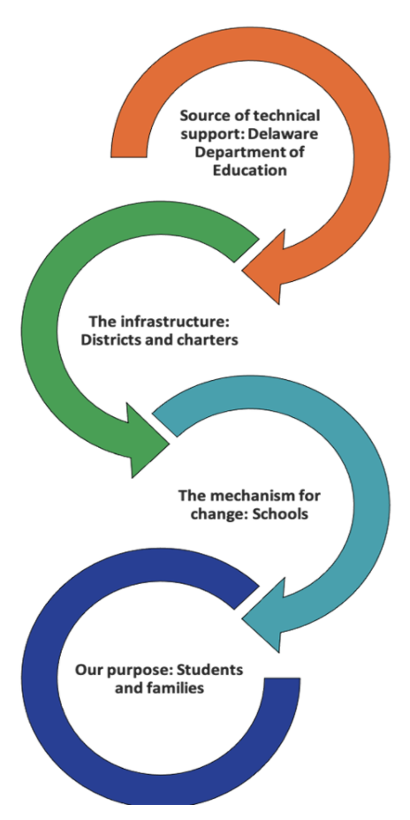
Delaware Multi-Tiered System of Support School Needs Inventory Rubric
DE-based tool to establish baseline data of the systems and practices of MTSS and to monitor ongoing school-level implementation
Supports the integration of academic and non-academic MTSS
Delaware Multi-Tiered System of Support School Needs Inventory Rubric

Slide 44
Integrated Teaming
MTSS Implementation Rubric
Item | Little or No Implementation 1 | Partial or Inconsistent Implementation 3 | Complete and Consistent Implementation 5 | Notes/ Evidence to Support Ratings
Integrated Teaming | The MTSS team does not have the needed staff, expertise, or processes to integrate academic and nonacademic interventions and supports; or there are separate academic and nonacademic teams, and a process is not in place to integrate academic and nonacademic teams, interventions, and supports. | The MTSS team has begun developing the needed staff, expertise, and processes to integrate academic and nonacademic interventions and supports. If there are separate academic and nonacademic teams, the teams have begun developing processes to integrate academic and nonacademic teams, interventions, and supports, but these processes are not well defined or consistently implemented | The MTSS team has the needed staff, expertise, and processes in place to integrate academic and nonacademic interventions and supports. If there are separate academic and nonacademic teams, the teams meet on a regular basis to ensure alignment of academic and nonacademic supports and to address the needs of students who require both academic and nonacademic intervention
Delaware Multi-Tiered System of Support School Needs Inventory Rubric

Slide 45
MTSS Team Process
MTSS Implementation Rubric
Item | Little or No Implementation 1 | Partial or Inconsistent Implementation 3 | Complete and Consistent Implementation 5 | Notes/ Evidence to Support Ratings
MTSS Team Process | Only one of the following conditions is met: (1) the MTSS team is representative of all key stakeholders; (2) structures and clear processes are in place to guide decision making; and (3) time is set aside for the team to meet regularly. | At least two of the following conditions are met: (1) the MTSS team is representative of all key stakeholders; (2) structures and clear processes are in place to guide decision making; and (3) time is set aside for the team to meet regularly. | All of the following conditions are met: (1) the MTSS team is representative of all key stakeholders; (2) structures and clear processes are in place to guide decision making; and (3) time is set aside for the team to meet regularly.
Delaware Multi-Tiered System of Support School Needs Inventory Rubric

Slide 46
At end of each meeting, conduct a BRIEF assessment of the meeting by asking 6 questions
Evaluation of Team Meeting (Mark your ratings with an “X”) | Our Rating
 | Yes | No | So-So
1. Was today’s meeting a good use of our time? | X
2. In general, did we do a good job of tracking whether we’re completing the tasks we agreed on at previous meetings? | X
3. In general, have we done a good job of actually completing the tasks we agreed on at previous meetings? |  |  | X
4. In general, are the completed tasks having the desired effects on intended outcomes? |  |  | X
5. Did the meeting start on time? |  | X
6. Did the meeting end on time? | X

Slide 47
Team Temperature Check
Indicator | 3=Usually 2=Sometimes 1=Rarely
1. I show up as my best self to our team meetings.
2. I look forward to our meetings.
3. I feel that I can meaningfully contribute during our meetings.
4. I feel that team members are respectful to each other.
5. I feel that we all learn from each other.
6. I feel that the facilitator/lead holds a safe space for learning and collaboration.
7. I feel that our work together will serve our students.
8. I feel that our work together stays focused on our purpose, goals, or projects.
9. I leave our meetings feeling stretched, energized, and/or inspired.
10. I feel that my feedback on our meetings is acknowledged.
TOTAL
The Art of Coaching Teams

Slide 48
Wrap Up Team Time
What are the shared outcomes we are working toward?
How are we currently organized to do this work and what adjustments might enhance our ability to do this work (teaming structure alignment/working smarter)?
What other voices could contribute to the effectiveness of this team?
How do you already include youth & family voice and in what ways might you enhance your efforts (teaming, communication plan, leverage existing efforts)?
What team operating procedures do we currently use and what practices might enhance our effectiveness & efficiency?
9
Yanek, K. (2021, August 11). Project DelAWARE & Interconnected Systems Framework (ISF)

Slide 49
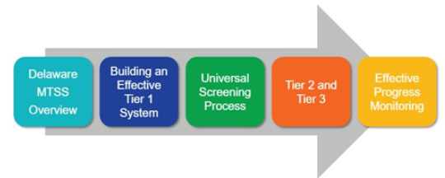
Next Steps for Continued Learning
DE-PBS Online Learning
https://www.delawarepbs.org/
http://www.delawarepbs.org/pd/
DE-MTSS Materials & Modules
https://www.doe.k12.de.us/domain/613
Five 40-minute self-paced modules
Register: PDMS 30120
Delaware SEBW Plan
https://www.doe.k12.de.us/Page/4474

Slide 50
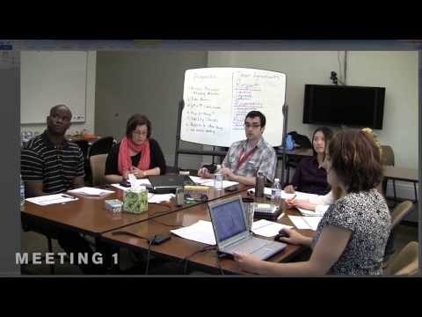
More Continued Learning
Tier 1 Team Meeting Demonstration using the TIPS II Model
University of Oregon TIPS Presentation

Slide 51
The DE-PBS Project serves as a technical assistance center for the Delaware DOE to actualize the vision to create safe and caring learning environments that promote the social-emotional and academic development of all children.
The statewide initiative is designed to build the knowledge and skills of Delaware educators in the concepts and evidence-based practices of Positive Behavior Support (PBS) as a Multi-tiered System of Support (MTSS).

Slide 52
Thank you!
For questions or support on this module, please contact:
Brynn Fallah
bfallah@udel.edu
DE-PBS Project Coach
Center for Disabilities Studies
University of Delaware

Slide 53
Resources
Aguilar, E. (2016). Coaching teams tools. The Art of Coaching Teams: Building Resilient Communities that Transform Schools. Bright Morning.
Algozzine, B., Barrett, S., Eber, L., George, H., Horner, R., Lewis, T., Putnam, B., Swain-Bradway, J., McIntosh, K., & Sugai, G (2014). School-wide PBIS Tiered Fidelity Inventory. OSEP Technical Assistance Center on Positive Behavioral Interventions and Supports.
American Institutes for Research [AIR]. (n.d.). Center on MTSS.
Borgmeier, C. (n.d.). The Team Initiated Problem Solving (TIPS II) training manual [PowerPoint Slides]. Portland State University.
Delaware Department of Education [DDOE]. (2020). DE-MTSS essential component: Team-based leadership [Infographic].
Delaware Department of Education. (2021, Jan 19). Delaware Multi-Tiered System of Support school needs inventory rubric.
Delaware Department of Education. (2021, July 21). Delaware's MTSS Framework.
Delaware Positive Behavior Support Project [DE-PBS]. (2021). Teaming slides: Mid-Atlantic PD.
Horner, R. (n.d.). Team Implemented Problem Solving (TIPS) [PowerPoint Slides]. University of Oregon.
Martin, M. (2020, February 10). The state of meetings in 2020. Clockwise.
McIntosh, K., & Goodman, S. (2016). Integrated multi-tiered systems of support: Blending RTI and PBIS. Guilford Press.
Todd, A. W., Algozzine, B., Horner, R. H., Preston, A. I., Cusumano, D., & Algozzine, K. (2019). A descriptive study of school-based problem-solving. Journal of Emotional and Behavioral Disorders, 27(1), 14–24.
Turmel, L. (2022, February 14). State of meetings at work – The results [Infographic]. Beenote.
Yanek, K. (2021, August 11). Project DelAWARE & Interconnected Systems Framework (ISF): Day 1 [PowerPoint Slides]. Delaware Positive Behavior Support Project.

