Slide 1
DE-PBS Cadre Meeting
April 12, 2017
WELCOME COACHES

Slide 2
Congratulations & Thank you, Melanie!

Slide 3
Professional Development
Spring – Summer 2017

Slide 4
School Climate Data Workshop 5/11/17
Open to all participating schools & district support staff
Del-tech – Dover, DE
Morning workshop
Statewide overview
Understanding data reports & interpretation tools
Staff & student voice
Data Processing Time – Available space & support until 3:00

Slide 5
SWPBS Team Training 6/28/17
SWPBS Team Training – 3 session series (2 summer, 1 fall)
Think of potential teams based on interest and need
Support Readiness
Planning with administration; Administrator buy-in is key
Discussion of team structure
Overview of MTSS & Tier 1 efforts

Slide 6
Housekeeping reminder- Substitute Reimbursement
The Department of Education will provide substitute reimbursement for REGISTERED participants.
PFA or IV needs to be completed within 30 days after the training. Please send completed PFA or IV electronically to Valencia Harper (valencia.harper@doe.k12.de.us).

Slide 7
Data Reminders: DDRT & DASNPBS
DE Assessment of Strengths and Needs
Currently available for use through June 2017
10 question survey per implementation area
Staff perspective on program strength/weakness for use in planning
Discipline Data Reporting Tool (DDRT)
Template available on website
Submission 2x per year
January 13th
June 23rd

Slide 8
DE-PBS Key Feature Update

Slide 9
2016 -17 DE-PBS Key Feature Evaluation Update
11 Key Feature Evaluations completed to date
6 School Districts Represented
Brandywine (2) Christina (3) Charter (1) Colonial (1) Milford (2) Red Clay (1) Woodbridge (1)
6 Exemplary Schools!
*Forwood Elementary * Phyllis *Phyllis Wheatley Elementary
*Lancashire Elementary * *Shue- *Shue-Medill Middle
*Cooke Elementary * *West Park Elementary

Slide 10
Phase Recognition & KFE
For Phase 2, schools must have earned an overall implementation of PROFICIENT or EXEMPLARY on the DE-PBS Key Feature Evaluation (KFE).
If there are schools interested in applying for Phase 2 that have not had a KFE, or would like the opportunity to have a Key Feature Re-evaluation to demonstrate improved implementation, they must contact Lynn Moss (lynnlm@udel.edu) no later than April 18th to allow time to schedule a school visit.

Slide 11
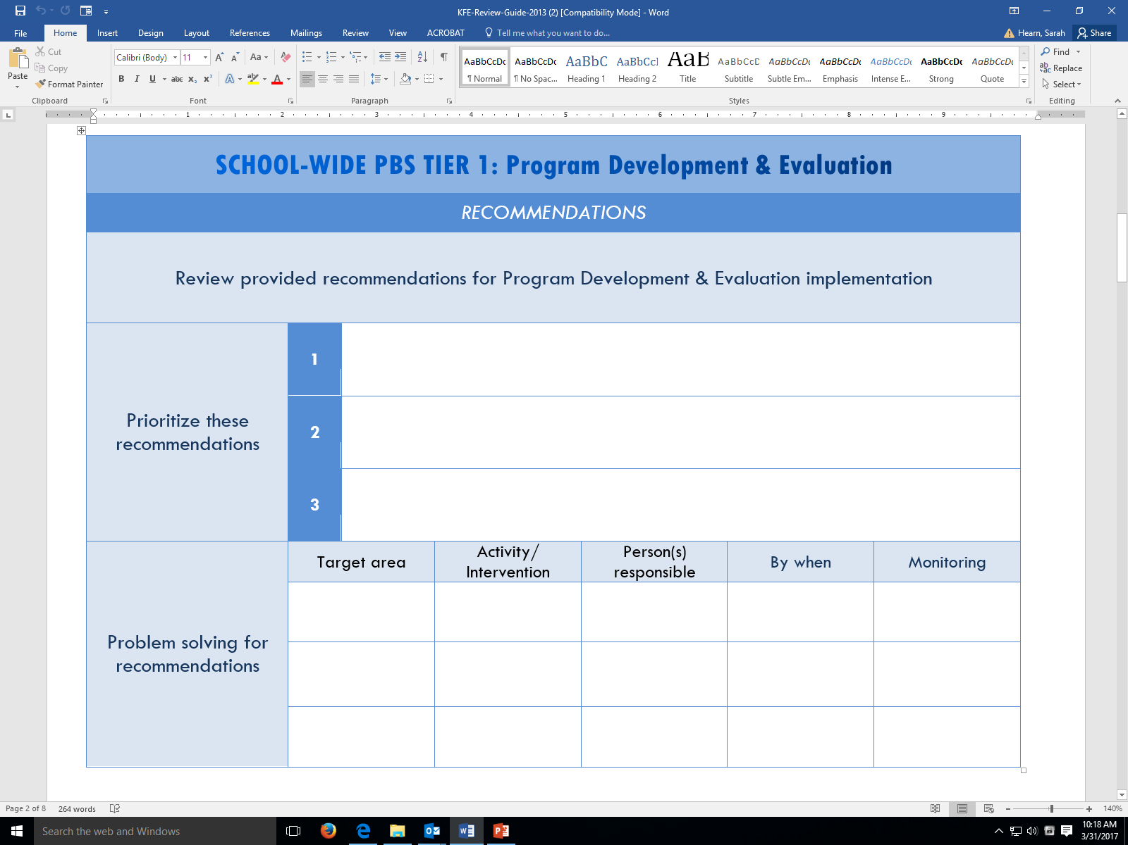
KFE Action Plan Guide

Slide 12
Phase Recognition Reminders
2016-2017

Slide 13
Dates to Remember
Applications due Friday, June 30, 2017
If confirmation is not received by July 14, 2017 please contact Sandi Bradford.
District Coaches are great resources for application review and feedback.
Project Staff can review applications beforehand if received by May 1, 2017.
If a KFE is required or wanted, please contact Lynn Moss (lynnlm@udel.edu) no later than April 18, 2017
Notifications sent the week of September 14, 2017

Slide 14
Phase 1
You should apply for Phase 1 if:
Your building has been implementing SWPBS for one year or more
You have an established team that meets regularly
You regularly collect and review data including referrals, attendance, and grades
Your school has participated in the Delaware School Climate Survey or the DASNPBS (staff self-assessment)
Your staff has received PD related to PBS annually

Slide 15
Phase 2
You should apply for Phase 2 if:
Your building has been implementing SWPBS for two years or more
Your school has received a DE Key Features Evaluation and earned an overall score of PROFICENT or EXEMPLARY
Your SWPBS team makes decisions based on data including the “Big 5”
Your school has previously earned Phase 1 Recognition

Slide 16
Phase 3
You should apply for Phase 3 if:
Your building has an established Tier 1/ School-wide System
Your building has a Tier 2 Team that meets regularly
Your team has established at least one skill building and one relationship building intervention
Your team uses data to identify students in Tier 2
Your school has previously earned Phase 2 Recognition

Slide 17
Phase 4
You should apply for Phase 4 if:
Your building has an established Tier 2 team that meets regularly
Your team monitors the success of interventions using data such as the Intervention Tracking Tool
Your team has a written process for Tier 2 interventions that is shared with staff
Your school has previously earned Phase 3 Recognition

Slide 18
From the field…
You must receive Phase 2 recognition before Phases 3 or 4
You can only apply for one Phase each year
If your school has received an “EXEMPLARY” overall score on the KFE this year, Phase 2 will automatically be awarded. However, if a higher Phase is sought, and application must be completed.
Additional assessments such as the School Climate Survey or DASNPBS are not required beyond Phase 1

Slide 20
It’s a Conversation
Do you have district conversations encouraging folks to apply for recognition?
Do you have time available to provide TA in completing the application process?
How do you use the recognition application or process as a tool? with your teams?

Slide 21
Significant Disproportionality
April 2017
DE-PBS Cadre

Slide 22
Significant Disproportionality
20 U.S.C. 1418(d) and 34 CFR §300.646
Determine whether significant disproportionality based on race/ethnicity is occurring with respect to:
The identification of children as children with disabilities, including identification as children with particular impairments;
The placement of children in particular educational settings;
The incidence, duration, and type of disciplinary actions, including suspensions and expulsions.

Slide 23
Significant Disproportionality
Disciplinary Actions: Must consider all three areas (incidence, duration, type)
For example:
Number of out-of-school suspensions/ expulsions of 10 days or less
Number of out-of-school suspensions (including expulsions) of greater than 10 days
Number of in-school suspensions of 10 days or less
Number of in-school suspensions of greater than 10 days
Total number of disciplinary removals

Slide 24
Significant Disproportionality
17-18 School year data will be the starting point for the new requirements
There will be reporting requirements for districts
States can choose:
Calculation methodology;
Definition of significant disproportionality;
Minimum cell size requirements;
To use multiple years of data.

Slide 25
Tier 1 – School-wide Systems

Slide 26
Universal Screening

Slide 27
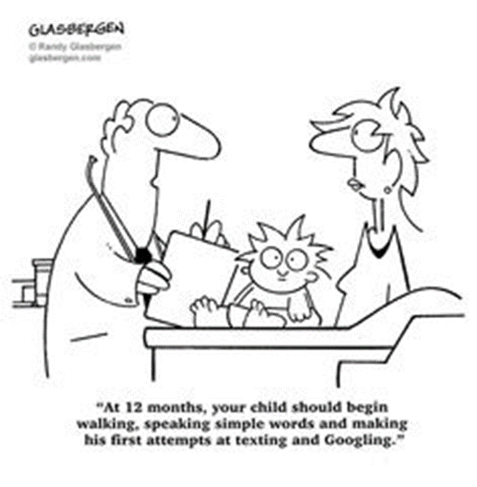
Universal Screening Defined…
“Universal screening is the systematic assessment of all children within a given class, grade, school building, or school district, on academic and/or social-emotional indicators that the school personnel and community have agreed are important.”
Source: Ikeda, Neessen, & Witt, 2009

Slide 28
Advantages of Screening for Behavior
Preventative
Provides earlier intervention to those at risk for behavioral and social emotional difficulties
Attending to student social emotional and behavior needs early via screening have been shown to:
Improved academic outcomes
Improve positive school climate
Improve interpersonal relations

Slide 29
School-wide Base Rate
ELEMENTARY SCHOOLS | 1st Screener (2016-17)
School A
Internalizing | 19.3%
Externalizing | 26.2%
School B
Internalizing | 12.0%
Externalizing | 25.9%
School C
Internalizing | 15 %
Externalizing | 23.7%
SECONDARY SCHOOLS | 1st Screener (2016-17)
School A
Internalizing | 35.1%
Externalizing | 17.6%
School B
Internalizing | 28.4%
Externalizing | 14.9%
School B
Internalizing | 42.6%
Externalizing | 18.9%
How might your school use the following data?
Eber & Barrett, 2017

Slide 30
The Need to Be Plan-ful
Implementation occurs in stages
Exploration-Adoption
Installation
Initial Implementation
Full Implementation
Innovation
Sustainability
2 to 4 Years
Fixsen, Naoom, Blase, Friedman, & Wallace, 2005

Slide 31
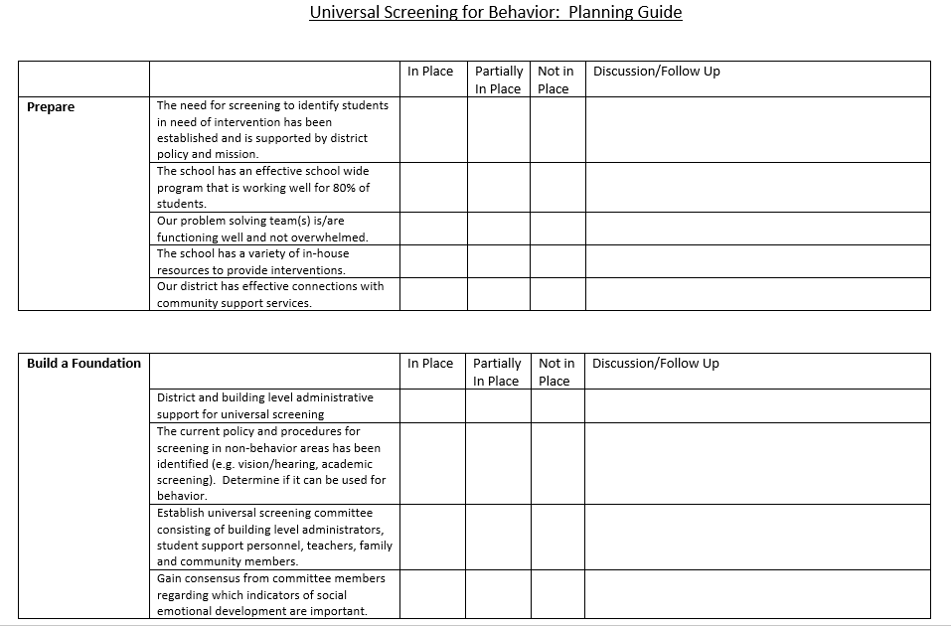
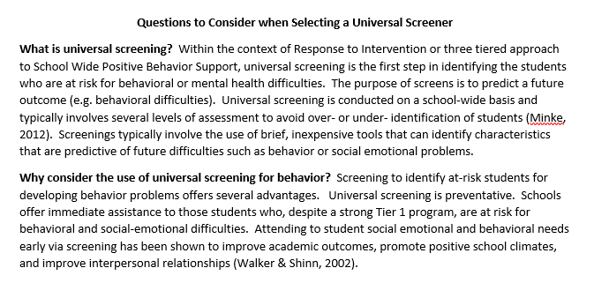
Planning Tool
Critical Questions to Consider
Delawarepbs.org

Slide 32
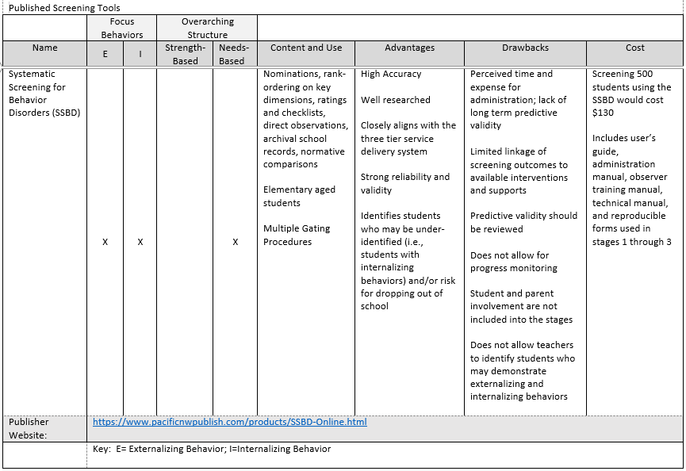
A Review of Commonly Used Social and Emotional Screening Tools

Slide 33
Is a school ready to do this?
What are the district policies and resources related to screening?
Does a school have an effective school wide program that is working well for 80-85% of your students?
Is a problem solving team functioning well or overwhelmed?
What in-school resources are available to provide interventions?
Does the district have effective connections with community support services?

Slide 34
How do we move beyond the need? Selecting an intervention…
Questions to consider when selecting a universal screener
Universal screener planning guide
A brief review of available universal screening tools

Slide 35
Types of Universal Screeners
Informal Screening Tools
Formal Screening Tools
Systematic Screening for Behavior Disorders (SSBD)
BASC-3 Behavioral and Emotional Screening System (BESS)
Behavior Intervention Monitoring Assessment System (BIMAS)
Social Skills Improvement System Performance Screening Guide (SSIS PSG)
Devereux Student Strengths Assessment (DESSA) and DESSA Mini
Developmental Assets Profile (DAP)
Strengths and Difficulties Questionnaire
ODR Attendance Academic Data | Time on Task Create your own

Slide 36
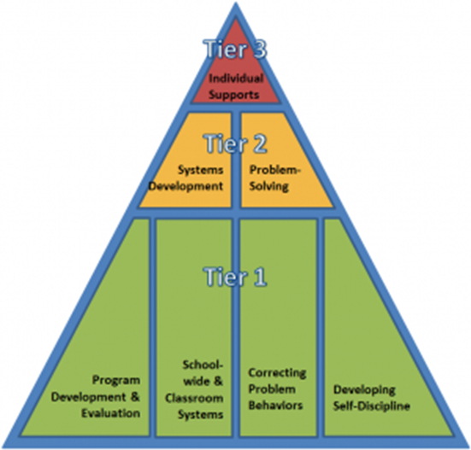
Follow-up Questions
What are your current screeners or screening processes for behavior?
In what way does your system use the screening data to identify students in need of intervention?

Slide 37
Supporting & Responding to Behavior
ACTIVITY TIME!

Slide 38
Supporting & Responding to Behavior
Evidence-Based Classroom Strategies for Teachers

Slide 39
District Reflection
What are the district’s policies/expectations regarding classroom managements?
What are the district’s resources to support PCBS?
Are PCBS supports/conversations linked to MTSS/PBS message?
Do your schools assess their classroom management needs? How so?
Do your schools provide classroom management supports to staff? What does this look like?

Slide 40
Resource created by OSEP Technical Assistance Center on Positive Behavior Interventions and Supports to summarize positive classroom behavior management strategies for educators.
Strategies are most effective when implemented within a school-wide framework that directly link to classroom practices, supports effective instructional design and delivery, and use classroom based data to guide decision making.
Includes:
Interactive map of classroom PBIS strategies
Self assessment
Examples and non examples of critical practices
Links to resources
Scenarios that illustrate implementation.

Slide 42
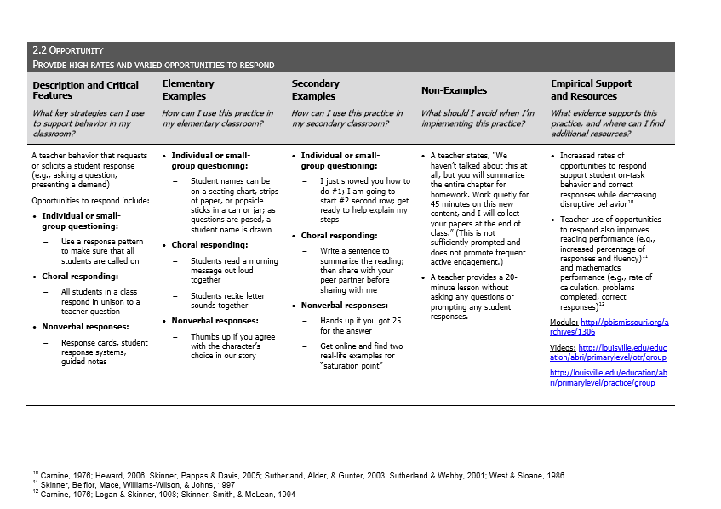
For more information see: http://www.pbis.org/common/cms/files/pbisresources/Supporting%20and%20Responding%20to%20Behavior.pdf

Slide 43
Let’s go! pbis.org

Slide 44
Tier 2 – Targeted Systems

Slide 45
Tiered Fidelity Inventory – Tier 2
Inputting Data Into the TFI

Slide 46
Purpose of the PBIS Tiered Fidelity Inventory
The purpose of the School-wide PBIS Tiered Fidelity Inventory is to provide an efficient and valid index of the extent to which PBIS core features are in place within a school.
Tier I (Universal PBIS)
Whole School Universal Prevention
Tier II (Targeted PBIS)
Secondary, Small Group Prevention
Tier III (Intensive PBIS)
Tertiary, Individual Support Prevention

Slide 47
Uses of the SWPBIS Tiered Fidelity Inventory
Formative Assessment
Determine current PBIS practices in place and needed prior to launching implementation
Progress monitoring
Self-assess PBIS practices by tier to guide implementation efforts, and assess progress by tier
Build action plan to focus implementation efforts
Annual Self-Assessment
Self-assess annually to facilitate sustained implementation of PBIS

Slide 48
TFI Summary Data and Reports
Total Score
Cannot use this unless you complete all 3 tiers
Subscale
Currently we are only using tier 2 subscale
Sub-subscale
Individual Items

Slide 49
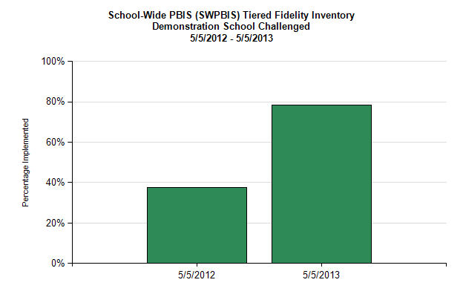
Total score (TFI)

Slide 50
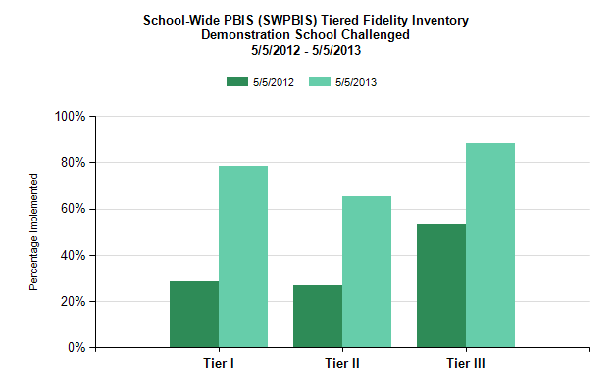
Sub-scale report

Slide 51
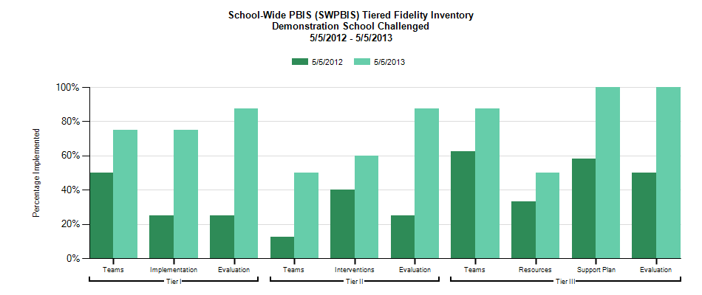
Sub-subscale report
Tier I
Teams
Implementation
Evaluation
Tier III
Teams
Resources
Assessment
Support plan
Monitoring and adaptation
Tier II
Teams
Interventions
Evaluation

Slide 52
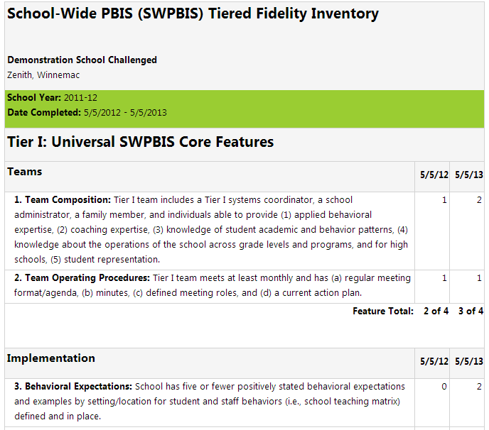
Item Report

Slide 53
Accessing the TFI as a coach
Access https://www.pbisapps.org/Pages/Default.aspx by typing it into your search bar.
Find “PBIS Applications Login” in the upper right-hand corner of the screen and click on it.
When you click “PBIS Applications Login,” the site will ask for your username and password. Enter those and press “Login.”
You should have received an email last night with log in information

Slide 55
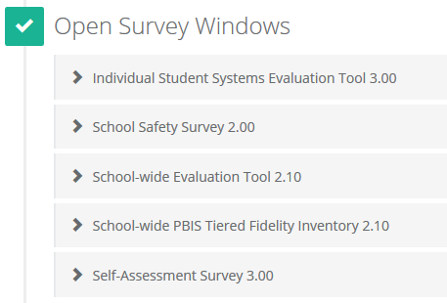
Finding the survey
Logging on will take you to your Dashboard
If you do not automatically arrive at your Dashboard, click on PBIS Assessment in the top left corner of the screen
Any survey that is open and ready for data entry will appear under “Open Survey Windows”

Slide 56
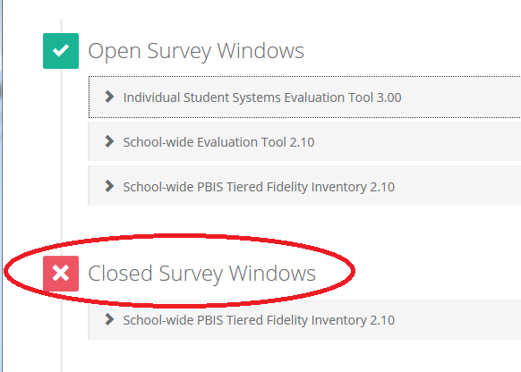
But wait! What if your survey is no longer “Open”
Scroll down below the “Open Survey” section until you see a red “Closed Survey” section
Click on the survey under “Closed Survey Windows” that you want to complete (School-wide PBIS Tiered Fidelity Inventory 2.10)

Slide 57
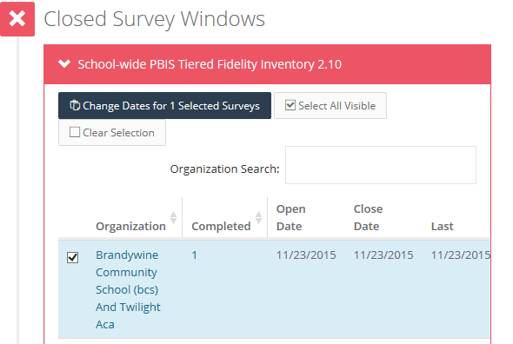
Opening a Closed Survey
When you click on your survey, you will see a list of organizations.
Click the box to the left of your school/organization’s name
There will be a dark blue box under the survey name that goes from “Change Dates for 0 Selected Surveys” to “Change Dates for 1 Selected Surveys” when you click on your school/organization. Click on that dark blue box.

Slide 58
Opening a Closed Survey Cont’d
A new box will pop up that says “Modify Open and Close Date”
Change the “close date” to either the current date or a future date. The survey will only remain closed if the “close date” has already passed.
Click “Update.”
Your survey should now be listed under “Open Survey Windows.”

Slide 59
Accessing Your Survey
Under your selected Open Survey, there is a row of headings
Under “Availability” there will be an option to click “Take Survey” if you have not yet input your organization’s data
Click “Take Survey” to begin
Be sure that you are filling in the answers for your intended sections (e.g., if you are focusing on Tier 2, scroll down to the Tier 2 questions and leave the Tier 1 and 3 questions blank)

Slide 60
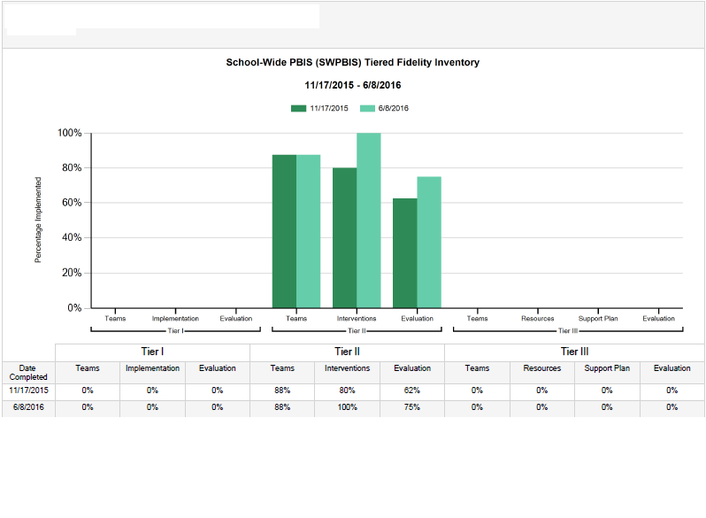
Graphing Your Results

Slide 61
Find Your School and Your Survey

Slide 63
Finding Your Graph
Clicking “View Reports” will bring you to a new page.
On the left hand side of the page, there is a column under “Report Options.”
Under this column, find “Select Report.” It will be preset to “Total.” Click on this drop down menu and change “Total” to “Subscale.”
Click “Generate” at the bottom of that column.

Slide 64
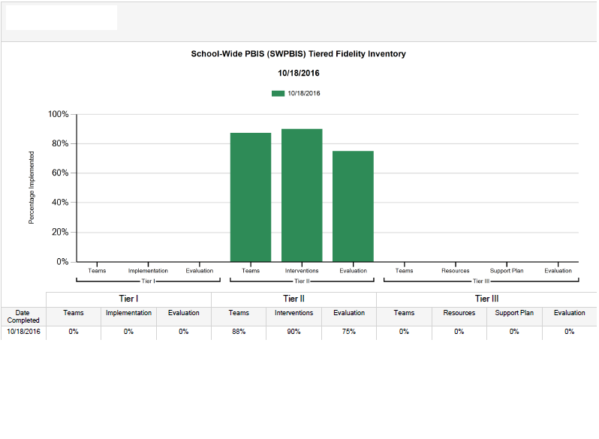
Saving Your Graph
Once you click “Generate,” your graph will appear.
If you would like to save your graph as a pdf, click “PDF” under the “Generate” and “Reset” buttons.
The PDF will open in a new window and you can save it from there.

Slide 65
Tiered Fidelity Inventory – Tier 2
Item Orientation

Slide 66
2.2 Team Operating Procedures
Subscale: Teams
Feature | Data Sources | Scoring Criteria
 |  | 0 = Not implemented 1 = Partially implemented 2 = Fully implemented
2.2 Team Operating Procedures: Tier II team meets at least monthly and has (a) regular meeting format/agenda, (b) minutes, (c) defined meeting roles, and (d) a current action plan. | Tier II team meeting agendas and minutes Tier II meeting roles descriptions Tier II action plan | 0 = Tier II team does not use regular meeting format/agenda, minutes, defined roles, or a current action plan 1= Tier II team has at least 2 but not all 4 features 2 = Tier II team meets at least monthly and uses regular meeting format/agenda, minutes, defined roles, AND has a current action plan
Main Idea: Tier II teams need meeting foundations in order operate efficiently and to implement effective supports.

Slide 67
2.3 Screening
Subscale: Teams
Feature | Data Sources | Scoring Criteria
 |  | 0 = Not implemented 1 = Partially implemented 2 = Fully implemented
2.3 Screening: Tier II team uses decision rules and multiple sources of data (e.g., ODRs, academic progress, screening tools, attendance, teacher/family/student nominations) to identify students who require Tier II supports. | Multiple data sources used (ODRs/Time out of instruction, Attendance, Academic performance) Team Decision Rubric Team meeting minutes School Policy | 0 = No specific rules for identifying students who qualify for Tier II supports 1 = Data decision rules established but not consistently followed or used with only one data source 2 = Written policy exists that (a) uses multiple data sources for identifying students, and (b) ensures that families are notified when a student enters Tier II supports
Main Idea: Timely selection of students for Tier II supports improves the effectiveness of Tier II implementation.

Slide 68
2.5 Sufficient Array of Tier II Interventions
What intervention options are available at the Tier II level?
Self-Assessment
Are there multiple Tier II interventions readily available?
Do they have an evidence base of effectiveness with students?
Scoring
0 = No Tier II interventions with documented evidence of effectiveness are in use
1 = Only 1 Tier II intervention with documented evidence of effectiveness is in use
2 = Multiple Tier II interventions with documented evidence of effectiveness matched to student need

Slide 69
Quick Check: 2.6 Tier II Critical Features
What critical features are embedded in Tier II supports?
Self-Assessment
Do all Tier II interventions include additional instruction/time for student skill development?
Do all Tier II interventions include additional structure/predictability?
Do all Tier II interventions include increased opportunities for feedback?
Scoring
0 = Tier II interventions do not promote additional instruction/time, improved structure, or increased feedback
1 = All Tier II interventions provide some but not all 3 core Tier II features
2 = All Tier II interventions include all 3 core Tier II features

Slide 70
2.9 Professional Development
Subscale: Interventions
Feature | Data Sources | Scoring Criteria
 |  | 0 = Not implemented 1 = Partially implemented 2 = Fully implemented
2.9 Professional Development: A written process is followed for teaching all relevant staff how to refer students and implement each Tier II intervention that is in place. | Professional Development Calendar Staff Handbook Lesson plans for teacher trainings School policy | 0 = No process for teaching staff in place 1 = Professional development and orientation process is informal 2 = Written process used to teach and coach all relevant staff in all aspects of intervention delivery, including request for assistance process, using progress report as an instructional prompt, delivering feedback, and monitoring student progress
Main Idea: Effective Tier II supports require participation of many adults in the school.

Slide 71
2.10 Level of Use
Subscale: Evaluation
Feature | Data Sources | Scoring Criteria
 |  | 0 = Not implemented 1 = Partially implemented 2 = Fully implemented
2.10 Level of Use: Team follows written process to track proportion of students participating in Tier II supports, and access is proportionate. | Tier II enrollment data Tier II team meeting minutes Progress monitoring tool | 0 = Team does not track number of students responding to Tier II interventions 1 = Student data monitored but no data decision rules established to alter (e.g., intensify or fade) support 2 = Team defines criteria and tracks proportion, with at least 5% of students receiving Tier II supports
Main Idea: Tier II supports that are used too little (e.g. 1%) or too much (e.g. 20%) are not sustainable.

Slide 72
2.11 Student Performance Data
Subscale: Evaluation
Feature | Data Sources | Scoring Criteria
 |  | 0 = Not implemented 1 = Partially implemented 2 = Fully implemented
2.11 Student Performance Data: Tier II team tracks proportion of students experiencing success (% of participating students being successful) and uses Tier II intervention outcomes data and decision rules for progress monitoring and modification. | Student progress data (e.g., % of students meeting goals) Intervention Tracking Tool Daily/Weekly Progress Report sheets Family communication | 0 = Student data not monitored 1 = Student data monitored but no data decision rules established to alter (e.g., intensify or fade) support 2 = Student data (% of students being successful) monitored and used at least monthly , with data decision rules established to alter (e.g., intensify or fade) support, and shared with stakeholders
Main Idea: Tier II team needs regular access to information about student success to be able to adapt and improve Tier II supports.

Slide 73
2.12 Fidelity Data
Subscale: Evaluation
Feature | Data Sources | Scoring Criteria
 |  | 0 = Not implemented 1 = Partially implemented 2 = Fully implemented
2.12 Fidelity Data: Tier II team has a protocol for on-going review of fidelity for each Tier II practice. | Tier II coordinator training District technical assistance Fidelity probes taken monthly by a Tier II team member | 0 = Fidelity data are not collected for any practice 1 = Fidelity data (e.g., direct, self-report) collected for some but not all Tier II interventions 2 = Periodic, direct assessments of fidelity collected by Tier II team for all Tier II interventions
Main Idea: Fidelity assessments should always be included as part of implementation practice.

Slide 74
2.13 Evaluation
Subscale: Evaluation
Feature | Data Sources | Scoring Criteria
 |  | 0 = Not implemented 1 = Partially implemented 2 = Fully implemented
2.13 Annual Evaluation: At least annually, Tier II team assesses overall effectiveness and efficiency of strategies, including data-decision rules to identify students, range of interventions available, fidelity of implementation, and on-going support to implementers, and evaluations are shared with staff and district leadership. | Staff and student surveys Tier II handbook Fidelity tools School Policy Student outcomes District Reports | 0 = No data-based evaluation takes place 1 = Evaluation conducted, outcomes not used to shape the Tier II process 2 = Evaluation conducted at least annually, and outcomes shared with staff and district leadership, clear alterations in process proposed based on evaluation
Main Idea: Any strategy or procedure needs to be reviewed at least annually and revised to remain current and match changes in the school.

Slide 75
Tier 3 – Individual Systems

Slide 76
Implementation of Behavioral Supports in the IEP

Slide 77
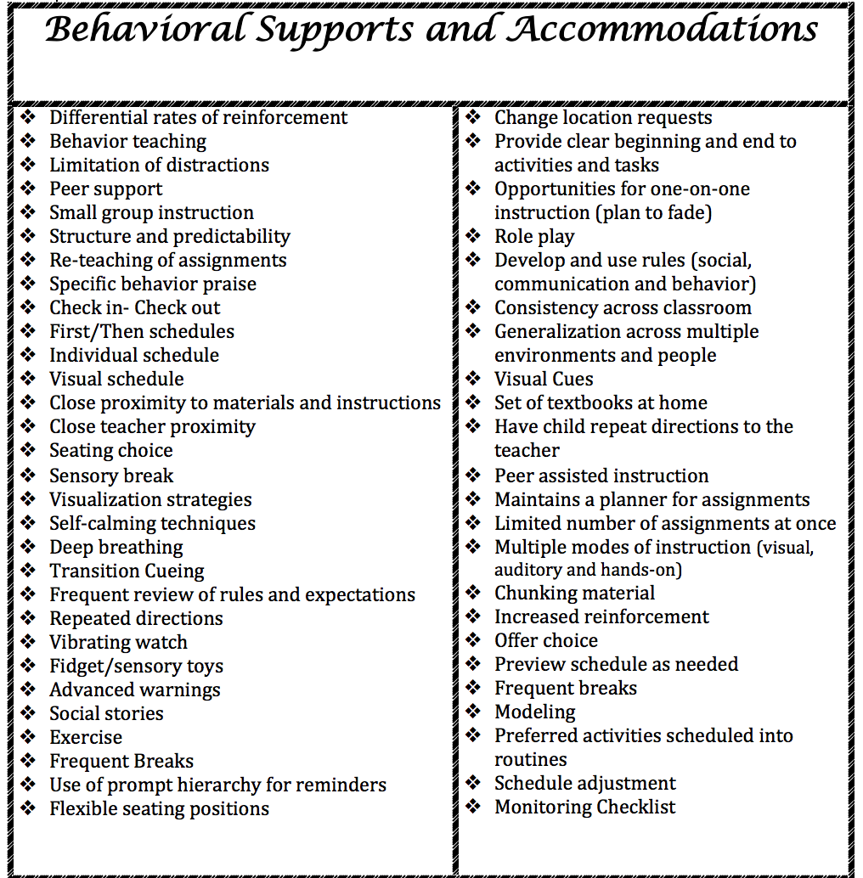
Any conversations started in your districts?

Slide 78
IEP Rubric for Behavior

Slide 79
Tier 3: Prevent Teach Reinforce (PTR) Building Capacity
At present, there are 7 trained Master Facilitators: capacity to train/coach new PTR facilitators in their district
Next steps:
Continued PD for districts in PTR from Dr. Iovannone
Continued training of new facilitators and Master Facilitators (2017-2018)
Tier 3 Systems and Redesign Support

Slide 80
Trained Master Facilitators by District

Slide 81
Schoology: Coaches Page
Brainstorm

Slide 82
Looking Forward

Slide 83
Coaching Reminders Thinking Ahead
Planning for summer team time
Discussing team leader transitions as needed
Discussing team membership transitions as needed

Slide 84
2017-2018 Cadre Planning
Are you happy with current timing?
3 Meetings
1/2 day sessions
Fall/Winter/Spring
Are you happy with current structure?
Updates (Data & PD)
Items for review & feedback
New ideas/tools to share
What topics would you like to see?

Slide 85
Please complete your evaluations.

